Slide 1

Single-season,
Single-species
Occupancy Models

Slide 2

Notes:
Sometimes the species for which we survey are obvious…

Slide 3

Notes:
…other times they are not obvious.

Slide 4
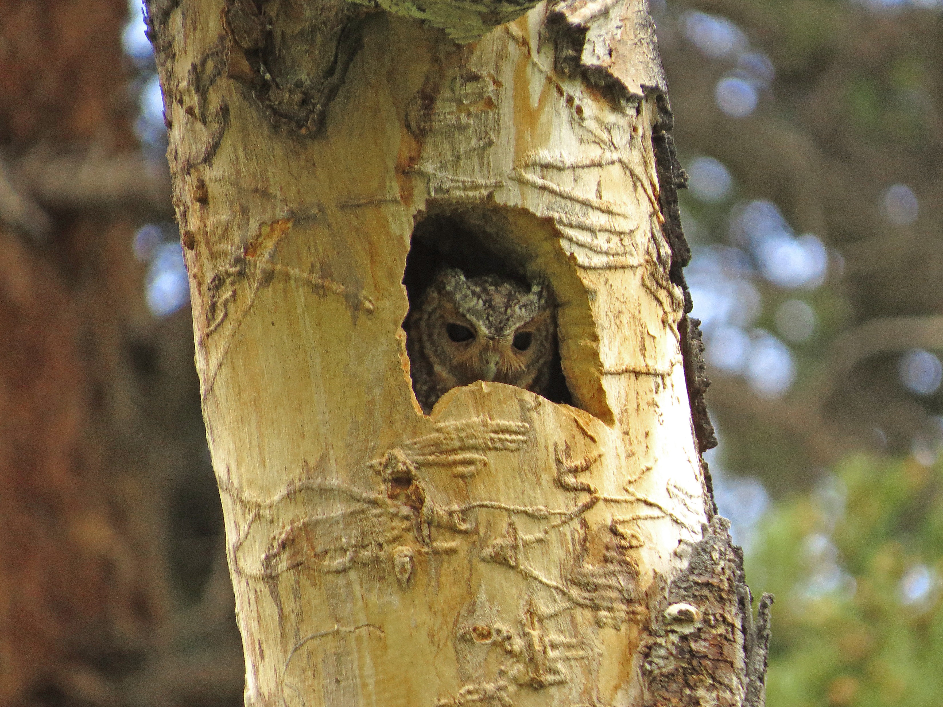
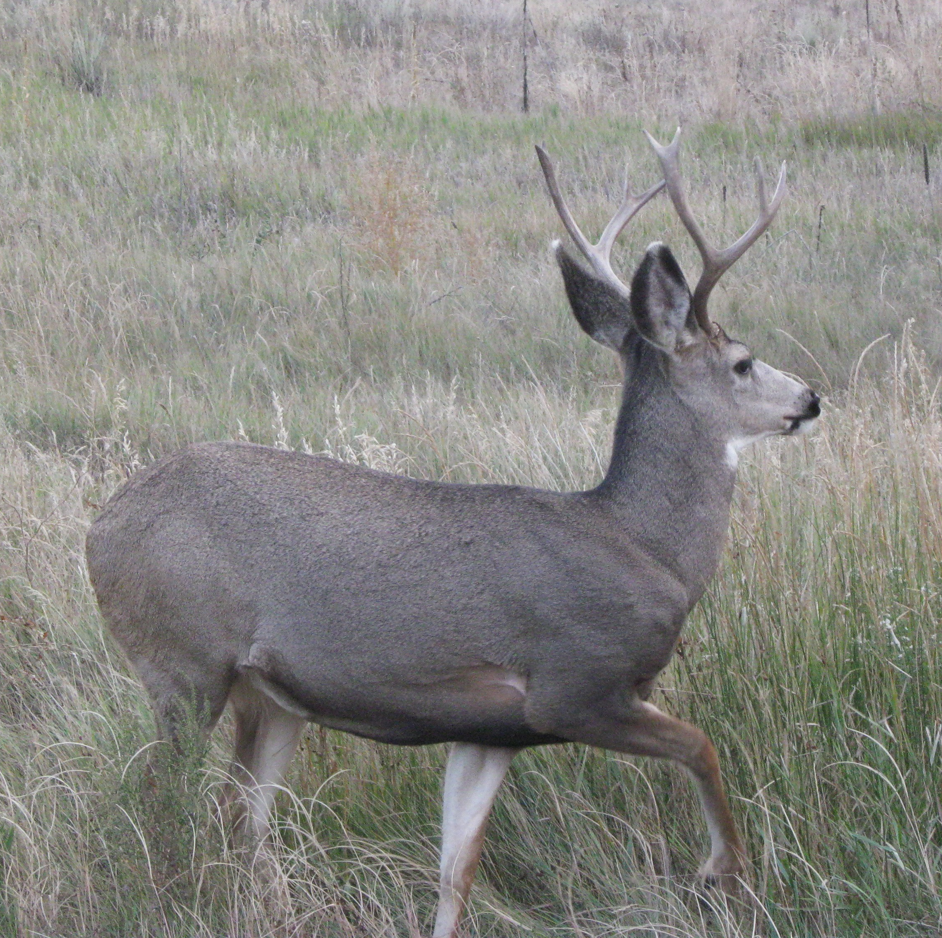
Survey area divided into sites
S: the set of all possible sites
s: the sample of sites observed
i: common index for sites

Slide 5
If the surveyor were perfect…
x: number of sites with detections
s: total number of sites
Ψ: probability (proportion) of occupancy
Notes:
We’d be done. Psi is easily calculated.
Discuss psi (probability of occupancy)
X=number of sites with detections

Slide 6
But surveyors are not perfect.
Previous approaches:
Modify field methods
Index counts; relative comparisons
Ad hoc methods – estimate detection probability separately

Slide 7
A model-based approach: introduction
Estimate both parameters at the same time:
ψ: probability of occupancy
p: probability of detection
Can use maximum likelihood or Bayesian methods
Appropriate estimates of uncertainty
Notes:
Could build a model to estimate both psi and p at the same time by making our response variable the detection history

Slide 8


A model-based approach: detection history (h_{i})
Site | Visit 1 | Visit 2 | Visit 3
1
2
3
4
i | … | … | …
h₁ = 1,1,1
h₂ = 1,0,0
h₃ = 0,0,0
h₄ = 1,0,1
h_{i} = …
Notes:
Detection history is our response variable

Slide 9
A model-based approach: parameters and probabilities
How can “1” arise?
The species was present, and the species was detected.
How can “0” arise?
The species was not present, or it was present and not detected
Notes:
Walk through

Slide 10
A model-based approach: detection histories as probability statements
h₁: 0, 0, 1, 1

Slide 11
A model-based approach: detection histories as probability statements
h₁: 0, 0, 1, 1

Slide 12
A model-based approach: detection histories as probability statements
h₁: 0, 0, 1, 1

Slide 13
A model-based approach: detection histories as probability statements
h₁: 0, 0, 1, 1

Slide 14
A model-based approach: detection histories as probability statements
CHECK YOURSELF!
Write the probability statement for the detection history:
h₁: 1, 0, 0, 1
Answer:

Slide 15
A model-based approach: the likelihood
Don’t worry about the math (unless you want to).
The point is that we can use standard tools to estimate ψ and p at the same time.
Notes:
Do this quick – it’s really just for the mathematically inclined. Show it, and move on – if people want more they can have it at the break.

Slide 16
A model-based approach: assumptions
How do we define a season?
Occupancy does not change during a season;
Probability of occupancy is equivalent across sites;
Probability of detection (given presence) is equivalent across sites;
Detection during each survey visit is independent of detection during other visits; and
Detection histories at each site are independent of each other.
For now…
This can be non-trivial (e.g., occupancy of a nest site)
Highly mobile species are problematic

Slide 17
Including Covariates
Occupancy does not change during a season;
Probability of occupancy is equivalent across sites;
Probability of detection (given presence) is equivalent across sites;
Detection during each survey visit is independent of detection during other visits; and
Detection histories at each site are independent of each other.

Slide 18
Linear models for ψ
Coefficients
Error
Link function
Covariates (data)
Notes:
This is just a simple linear model – don’t need to go too in depth here but just to show that this is really just logistic regression.

Slide 19



Including Covariates
Occupancy does not change during a season;
Probability of occupancy is equivalent across sites;
Probability of detection (given presence) is equivalent across sites;
Detection during each survey visit is independent of detection during other visits; and
Detection histories at each site are independent of each other.
Site | Visit 1 | Visit 2 | Visit 3
1
2
3
4
i | … | … | …

Slide 20
Covariates of Detection
Probability of detection can vary across sites and across visits.
Site-Level
Habitat
Acoustic properties
Visibility
Behavioral influences
Proximity to activity
Topography
Others
Site-Visit Level
Surveyor
Weather
Phenology: behavior
Phenology: habitat
Others

Slide 21
Building and Selecting Models
ψ: constant or as a function of site-level covariates
p: constant, as a function of site-level covariates, or as a function of site-visit-level covariates
Each model = a candidate hypothesis
1: ψ(.), p(.)
2: ψ(tree_ht), p(.)
3: ψ(tree_ht), p(observer)
4: ψ(covertype), p(observer)
5: ψ(tree_ht + covertype), p(observer)
6: ψ(tree_ht + covertype), p(observer + wind_speed)
Etc…..
Build multiple candidate models
Notes:
Stop and emphasize multiple competing hypotheses. Mention there are other approaches (GOF; NHST) but we’re dogmatically not discussiong them…

Slide 22
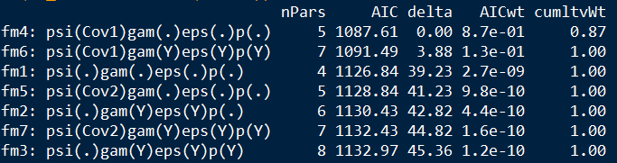
Building and Selecting Models
Akaike’s Information Criterion (AIC) or related information theoretic approaches
Parsimony: likelihood + penalty for model complexity

Slide 23
Building and Selecting Models
Model weights and evidence ratios

